Slide 1


Deep dive into predicting stock prices using technical indicators as well as sentiment analysis.
CZ1115 Mini - Project by Neel, Sashank and Wei Ling

Slide 2
Problem Definition
To explore the extent to which Amazon stock price predictions can be characterized by public sentiments on Twitter using multivariate regression and sentiment analysis.

Slide 3

Datasets used
Twitter API
Yahoo! Finance
Alpha Vantage Stock API (Amazon Stocks - AMZN)
Stock Time Series - Intraday
Technical Indicators - Small Moving Average ( SMA) and Exponential Moving Average ( EMA )

Slide 4

Data collection, curation and preparation
Coded functions to acquire intraday, EMA and SMA data using company stock ticker.
Data was cleaned and optimized to concatenate data frames to match in terms of date.
The required time frame was from 2001 - 2021, and the last 7 days were used to compare closing prices with predicted prices and polarity scores.
Ticks were concatenated in order to sort data and prepare for exploratory data analysis.

Slide 5
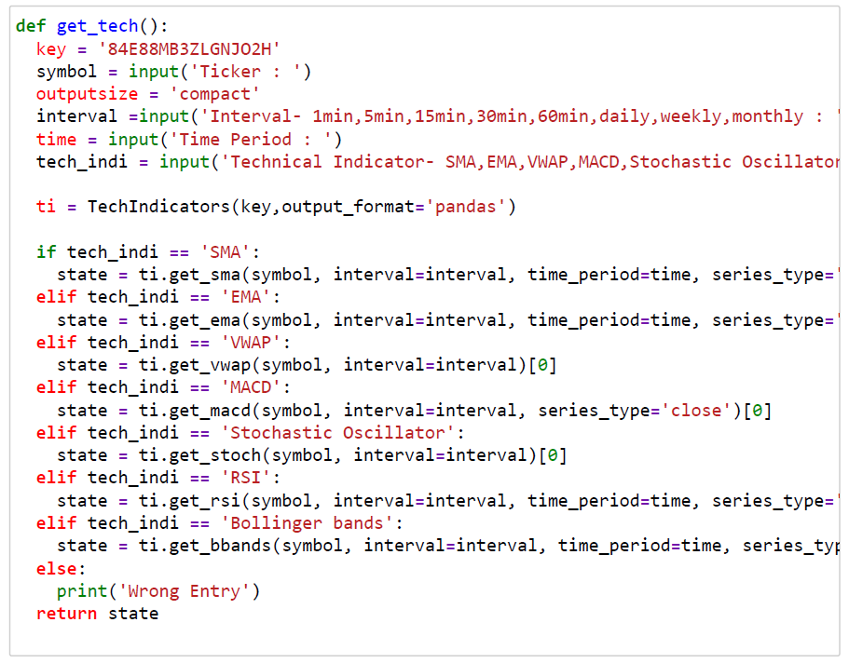
Utility functions used to curate data

Slide 6
Exploratory Analysis
Collected statistical information on the variables obtained.
Visualised the uni-variate distributions of each variable (EMA, SMA, CLOSE)
Visualised each variable against closing price using jointplot
Visualised correlation matrix using heatmap
Drew pairs of variables against each other using pairplot
Notes:
The main things that we have done for exploratory analysis are
Collected Statistical information
Uni-variate distribution on each variable
JointPlot
Visualise correlation matrix using heatmap
pairplot

Slide 7
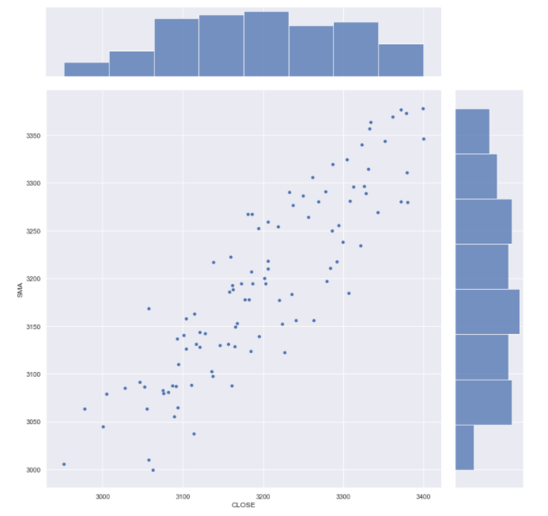
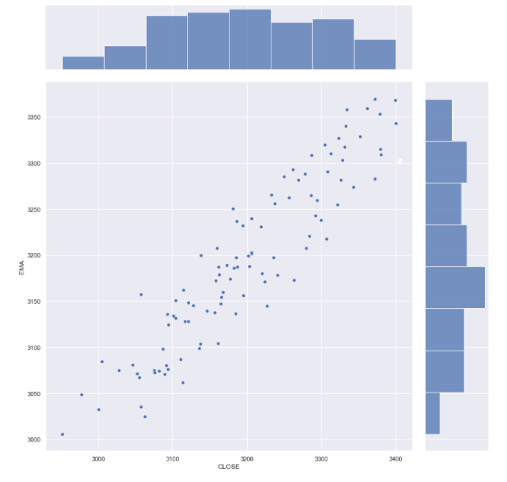
Exploratory Analysis - JointPlot
SMA vs CLOSE
EMA vs CLOSE

Slide 8
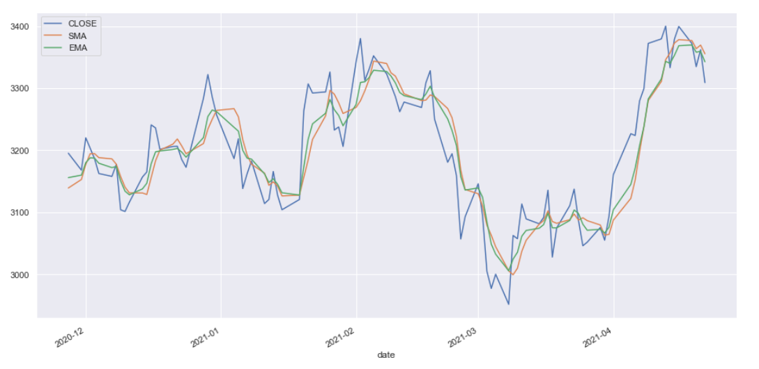
Visualization
SMA, EMA and Closing Prices against dates

Slide 9
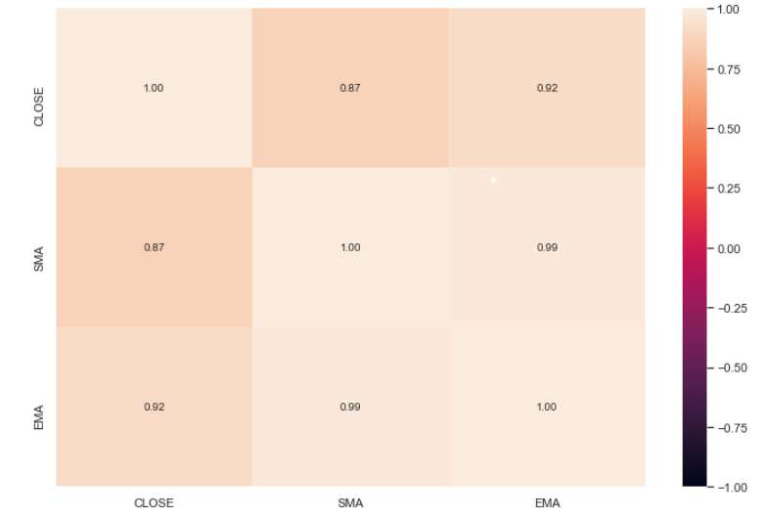
Exploratory Analysis - Heatmap

Slide 10
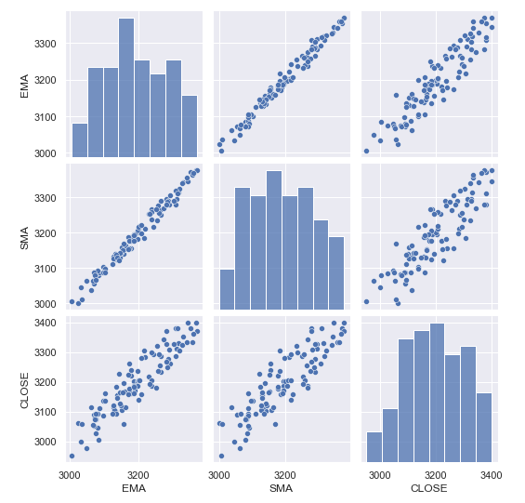
Exploratory Analysis -
Pairplots

Slide 11
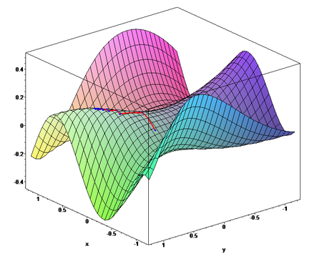
Multivariate Linear Regression
We decided to use multivariate linear regression for analysing the trends in the stock price and how good indicators such as SMA and EMA are in predicting the stock price.
Since our objective is to predict the future stock price and compare it with the public’s sentiment analysis, linear regression has to be used in order to predict the future stock price. Any other ML model such as classification will not work as this is a prediction problem.

Slide 12
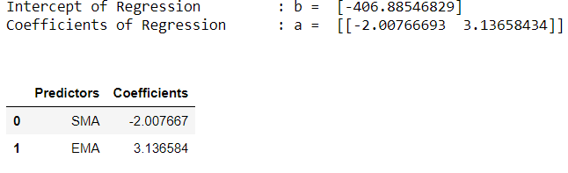
Methodology
We used the data that we extracted from alpha vantage as our independent variables. We extracted technical indicators(SMA,EMA) and used these to predict the closing price(dependent variable) of the Amazon stock.
To achieve this,, we created a train test split to get a train dataset and a test dataset(test size=0.2) . After fitting the data, we obtained the coefficients of regression for the dependent variables.
We then proceeded to obtain the R squared values and the MSE values for the train and test dataset respectively.

Slide 13
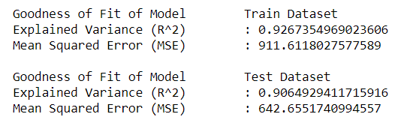
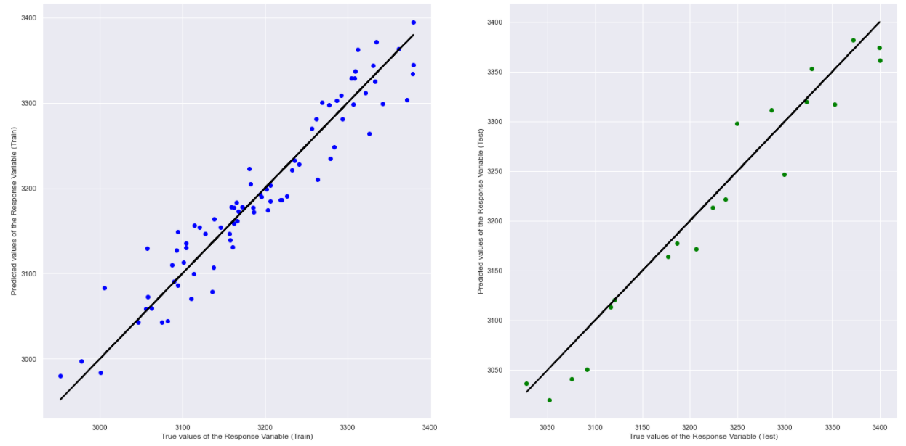

Slide 14


Sentiment Analysis
We decided to use sentiment analysis to compare and contrast our stock price prediction with the public’s opinion of Amazon to see a correlation.
Data was scraped from Twitter’s API using nltk and newspaper3k to get AMZN specific data.
Use of vader sentiment library to assess subjectivity and polarity to assign scores to data.
Used sentiment intensity analyzer to see a connect sentiment scores with stock prices.

Slide 15
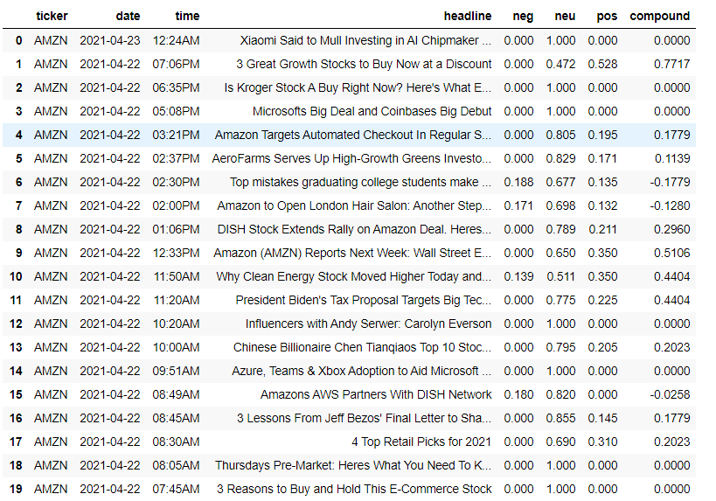
Compiled sentiment data frame using NLP

Slide 16
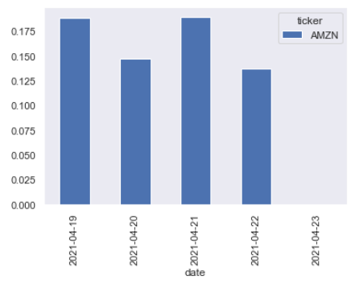
Histogram based on compound values
Y axis represents the compound scores
X axis is the last 7 days worth of data on AMZN
This correlation was further evidenced by similar movements in AMZN stock price graphed next:

Slide 17
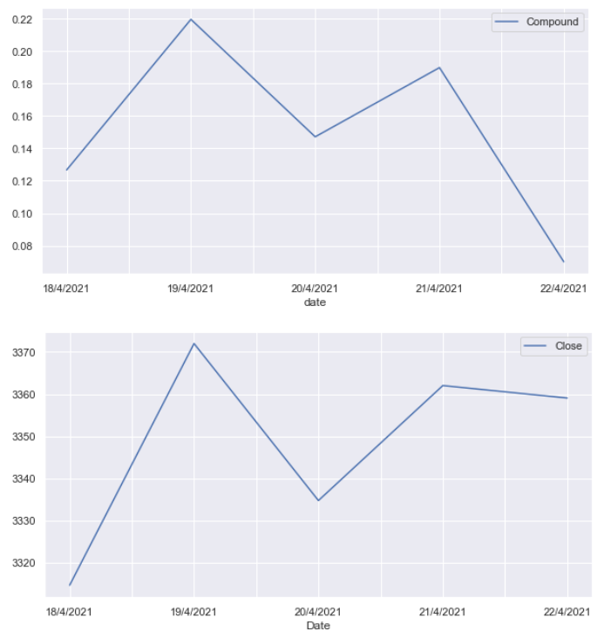
Trend analysis
First chart shows the variation of sentiments with respect to time in the last week.
Second chart shows the variation of closing price with respect to time in the last week,
We see a quite a strong correlation between sentiments and predicted price.

Slide 18
Data Driven Insights
While using public sentiments and opinions as a predictor of stock price was quite fun to play around with, we see that technical indicators such as SMA and EMA are obviously much more accurate to predict closing prices for AMZN, with a correlation score of more than 0.9
Our multivariate regression model had an R^2 value of 0.896 and a MSE value of 1419.193.
The coefficients of regression are 2.963 and -1.866 for EMA and SMA respectively. This indicates that if we are observing the closing price by using EMA and hold all the other independent variables constant, the closing price will change by a factor of 2.963.
These values show that SMA and EMA are extremely good variables for prediction of the closing price of the stock.
Moreover, positive and negative outlooks of the public on amazon affect Amazon’s trading stock price as seen by the plots and a correlation score of 0.64

Slide 19
Improvements and Sources of Errors
Access to a larger time frame of twitter data could have lead to a more vast comparison of sentiments and their relationship with stock prices for Amazon. More knowledge on natural language processing syntax could have also yielded a more accurate result.

Slide 20
Split up of Work
Importation of relevant libraries need for codes
Tidying up of code lines for better readability
Exploratory Analysis
Utility functions for extracting data from ticker
Web scraping and extracting data from twitter API
Sentiment Analysis and Trend Analysis
Data extraction into variables
Codes for combining the data
Plots of stock prices vs dates, technical indicators vs dates, Rolling mean vs dates.
Multivariate linear regression
Neel
Sashank
01
Wei Ling
02

Slide 21
References and Citations
(n.d) ‘Sentiment Analysis using Vader’, article retrieved from: https://towardsdatascience.com/sentimental-analysis-using-vader-a3415fef7664\
(n.d) ‘Multivariate Linear Regression’ article retrieved from https://www.hackerearth.com/practice/machine-learning/linear-regression/multivariate-linear-regression-1/tutorial/#:~:text=This%20is%20quite%20similar%20to,due%20to%20the%20added%20variables.\
(n.d) Visualizations, article retrieved from https://pandas.pydata.org/pandas-docs/stable/user_guide/visualization.html
(n.d) ‘NLP for beginners’, article and source files retrieved from https://www.analyticsvidhya.com/blog/2018/02/natural-language-processing-for-beginners-using-textblob/

Slide 22

Thank you.

